Slide 1
Neutrino Oscillations and Unknown Dark Matter
Is there a chance to connect mysterious neutrinos with even more mysterious dark matter?

Slide 2
Researchers
Lindsey Tensen
Anastasia I. Gorina

Slide 3
Outline
‘Little neutral ones’, aka neutrinos (why do they matter), and their place in Standard Model of Elementary Particles
Recent Studies (Discovery, detection, oscillations, etc.)
Neutrino Characteristics: Symmetry, Dirac/Majorana mass, Mass/Massless neutrinos, beta-decay
Theories about oscillations
Why do we care?
Dark matter compared to sterile neutrinos
Future research

Slide 4
References
Kalliopi Petraki (University of Melbourne). Sterile neutrinos as Dark Matter [http://lss.fnal.gov/conf/C0911181/Petraki_CosPA09.pdf]
Yuki Kamo, et al. Analytical calculations of four-neutrino oscillations in matter (, [https://arxiv.org/pdf/hep-ph/0209097.pdf]
C. L. Cowan Jr.; F. Reines; F. B. Harrison; H. W. Kruse; A. D. McGuire (1956). "Detection of the Free Neutrino: a Confirmation". Science. 124 (3212): 103–104.
Ahmad, Q. R.; et al. (SNO Collaboration) (2001). "Measurement of the Rate of νe + d → p + p + e− Interactions Produced by 8B Solar Neutrinos at the Sudbury Neutrino Observatory". Physical Review Letters. 87.
Arthur B. McDonald, Takaaki Kajita https://www.nobelprize.org/prizes/physics/2015/press-release/)
Griffiths, David J., and Darrell F. Schroeter. Introduction to Quantum Mechanics. Cambridge University Press, 2018.

Slide 5
Notations and terms
‘bra-ket’ notation for vector spaces
Wave function (describing particles):
Oscillations
Quantum superposition
Spin
$$|β>=\left[\begin{aligned}β_{1} \\ β_{2} \\ ... \\ β_{n}\end{aligned}\right]$$
$$<α|=[α_{1},α_{2},...,α_{n}]$$
$$Ψ(x,t)=ψ(x)e^{-iEt/ℏ}$$
$$\frac{L}{E}$$

Slide 6
Hilbert Space and Operators
Hilbert space: generalized notion of Euclidian space. It is a vector space of all square-integral functions of a specified interval f(x), and f(x) must be normalized:
Hilbert spaces are infinite dimensional vector spaces, where as Euclidean space is finite dimensions
Operators act on functions:
$$∫|ψ(x)|^{2}dx<∞$$
$$∫_{-∞}^{∞}|ψ(x)|^{2}dx=1$$
$$\frac{d}{dx}ψ(x)$$
$$\overset{̂}{Q}ψ=qψ$$

Slide 7
Probabilities
Probability of finding a particle with given wave function in the x interval from a to b, at time t:
The probability of finding a particle in a given region is considered to be the area under the graph of the wave function squared
In function space, we define bra-ket and the inner product to be:
For an observable with a discrete spectrum, the probability of getting eigenvalue associated with the orthonormalized eigenfunction :
$$P([a≤x≤b],t)=∫_{a}^{b}|ψ(x)|^{2}dx$$
$$<f|=∫f*[...]dx$$
$$|g>=∫gdx$$
$$<f|g>=∫f^{*}gdx$$
$$q_{n}$$
$$ψ_{n}$$
$$|<ψ_{n}|Ψ>|^{2}$$

Slide 8
Quantum Principles
In quantum mechanics particles of mass m can be represented by a wave function
Rather than representing the whole particle, we consider the wave function to be the probability of the particle being at point x at time t, which can be expressed mathematically as:
According to Heisenberg uncertainty principle, it is impossible to accurately measure equally the momentum and the position of the particle at the same time:
$$Ψ(x,t)=ψ(x)e^{-iEt/ℏ}$$
$$ΔxΔp≥\frac{ℏ}{2}$$

Slide 9
Schrödinger and Hamiltonian
Schrödinger’s Equation:
Where the potential energy could be dependent on x or any of its derivatives
We rewrite Schrödinger’s Equation as:
With the Hamiltonian:
$$\frac{-ℏ^{2}}{2m}\frac{d^{2}}{dx^{2}}Ψ+VΨ=iℏ\frac{d}{dt}Ψ$$
$$\frac{-ℏ^{2}}{2m}\frac{d^{2}}{dx^{2}}ψ+Vψ=Eψ$$
$$Hψ=Eψ$$
$$H=\frac{-ℏ^{2}}{2m}\frac{d^{2}}{dx^{2}}+V$$

Slide 10
CP Symmetry
C-Symmetry (charge conjugation): the laws of physics remain the same if we swap a particle with its anti-particle.
P-Symmetry (parity): The laws of physics remain the same for an inversion of coordinates, the mirroring of the system
Violation has not yet been observed experimentally
$$\left[\begin{aligned}x \\ y \\ z\end{aligned}\right]=\left[\begin{aligned}-x \\ -y \\ -z\end{aligned}\right]$$

Slide 11
Standard Model of Particle Physics
Up Mass 2.3 MeV/c^2 Charge 2/3 Spin 1/2 | Charm Mass 1.27 GeV/c^2 Charge 2/3 Spin 1/2 | Top Mass 173.07 MeV/c^2 Charge 2/3 Spin 1/2 | Gluon Mass 0 Charge 0 Spin 1 | Higgs Boson Mass 126 GeV/c^2 Charge 0 Spin 0
Down Mass 2,3 MeV/c^2 Charge 2/3 Spin 1/2 | Strange Mass 2,3 MeV/c^2 Charge 2/3 Spin 1/2 | Bottom Mass 2,3 MeV/c^2 Charge 2/3 Spin 1/2 | Photon Mass 0 Charge 0 Spin 1
Electron Mass 0.511 MeV/c^2 Charge -1 Spin 1/2 | Muon Mass 105.7 MeV/c^2 Charge -1 Spin 1/2 | Tau Mass 1.777 GeV/c^2 Charge -1 Spin 1/2 | Z-Boson Mass 91.2 GeV/c^2 Charge 0 Spin 1
Electron neutrino Mass <2.2 eV/c^2 Charge 0 Spin 1/2 | Muon neutrino Mass <0.17 MeV/c^2 Charge 0 Spin 1/2 | Tau neutrino Mass <15.5 MeV/c^2 Charge 0 Spin 1/2 | W-Boson Mass 80.2 GeV/c^2 Charge +- 1 Spin 1
Quarks
Leptons
Bosons
(Force carriers)
Quarks + Leptons =
Fermions (Matter)

Slide 12
Sources of neutrinos
Atmosphere
Sun (solar neutrinos)
Supernovae
Particle accelerators

Slide 13
Studies
Discovery of neutrino belongs to Clyde Cowan and Frederick Reines, who experimentally proved Wolfgang Pauli’s theoretical proposal (C. L. Cowan Jr.; F. Reines; F. B. Harrison; H. W. Kruse; A. D. McGuire (1956). "Detection of the Free Neutrino: a Confirmation". Science. 124 (3212): 103–104).
Neutrino oscillations were first discovered after observing the flow of solar neutrinos (Ahmad, Q. R.; et al. (SNO Collaboration) (2001). "Measurement of the Rate of νe + d → p + p + e− Interactions Produced by 8B Solar Neutrinos at the Sudbury Neutrino Observatory". Physical Review Letters. 87).
Neutrinos have no mass? Can they travel faster than light?
Neutrinos and Majorana vs Dirac mass

Slide 14
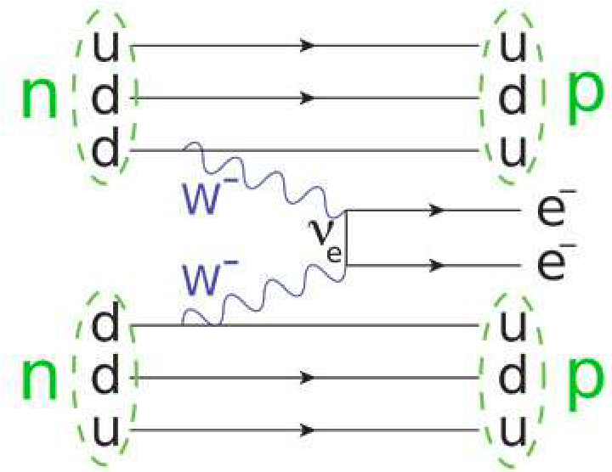
Neutrinoless Double Beta Decay
Fermi’s Golden Rule:
Decay Rate:
Majorana Exchange:
$$Γ_{i→f}=\frac{2π}{ℏ}|<f|H^{′}|i>|^{2}ρ$$
$$Γ=G|M|^{2}|mββ|^{2}$$
$$mββ=\overset{3}{\underset{i=1}{∑}}m_{i}U_{ei}^{2}$$
Feynman Diagram: Double Beta Decay
Allen, Roland. “Feynman diagram for neutrinoless double beta decay”. researchgate.net, Nov 2013. https://www.researchgate.net/figure/Feynman-diagram-for-neutrinoless-double-beta-decay-Credit-JabberWok2-Wikipedia_fig12_258423964

Slide 15
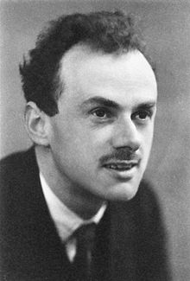
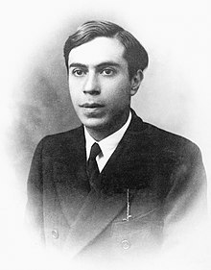
Dirac vs Majorana Mass
$$(βmc^{2}+c(\overset{3}{\underset{n=1}{∑}}α_{n}p_{n}))Ψ(x,t)=iℏ\frac{∂Ψ(x,t)}{∂t}$$
Dirac Equation:
Wave function of electron of mass m in spacetime coordinates:
Components of the momentum operator in SE:
$$Ψ(x,t)$$
$$p_{1}p_{2}p_{3}$$
Majorana Equation:
Majorana basis:
Charge conjugate of
Alternate expression:
$$i∂ψ+mψ_{c}=0$$
$$ψ_{c}=iψ^{*}$$
$$ψ:ψ_{c}$$
$$i∂ψ_{c}+mψ=0$$
Paul Dirac
Ettore Majorana

Slide 16
Seesaw Mechanism
Generic Model used to understand the relative sizes of observed neutrino masses (extension of Standard Model)
B = Majorana mass component, M = Dirac mass component
$$A=\left[\begin{matrix}0 & M \\ M & B\end{matrix}\right];B>>M$$

Slide 17
Massless Particle Theory
There are some particles that are confirmed to be massless, like photons or gluons
All of them are their own anti-particles
Arthur B. McDonald and Takaaki Kajita confirmed that neutrinos have mass by observing neutrino oscillations. They shared a Nobel Prize in 2015 (https://www.nobelprize.org/prizes/physics/2015/press-release/).

Slide 18
Sterile Neutrino
Mixing angles:
Right handed spin
Huge mass
$$θ_{14},θ_{24},θ_{34}$$

Slide 19
Oscillations depend on:
Mixing angles:
Mass splitting:
CP violation phase:
$$θ_{12},θ_{23},θ_{13}$$
$$δ\frac{m_{32}^{2}}{m_{31}^{2}}δm_{21}^{2}$$
$$e^{-iδ_{cp}}$$

Slide 20
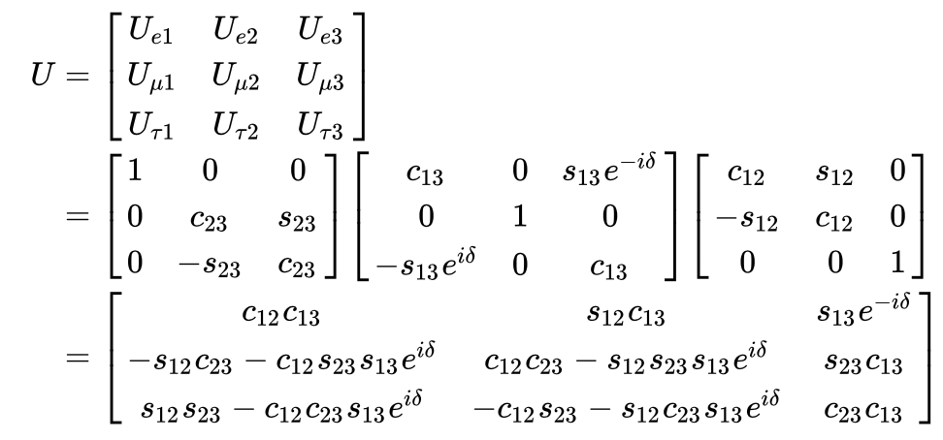
Pontecorvo–Maki–Nakagawa–Sakata matrix (aka PMNS matrix, lepton mixing matrix)
Wikipedia contributors. "Neutrino oscillation." Wikipedia, The Free Encyclopedia. Wikipedia, The Free Encyclopedia, 27 Sep. 2018. Web. 14 Oct. 2018.
3x3 PMNS Matrix

Slide 21
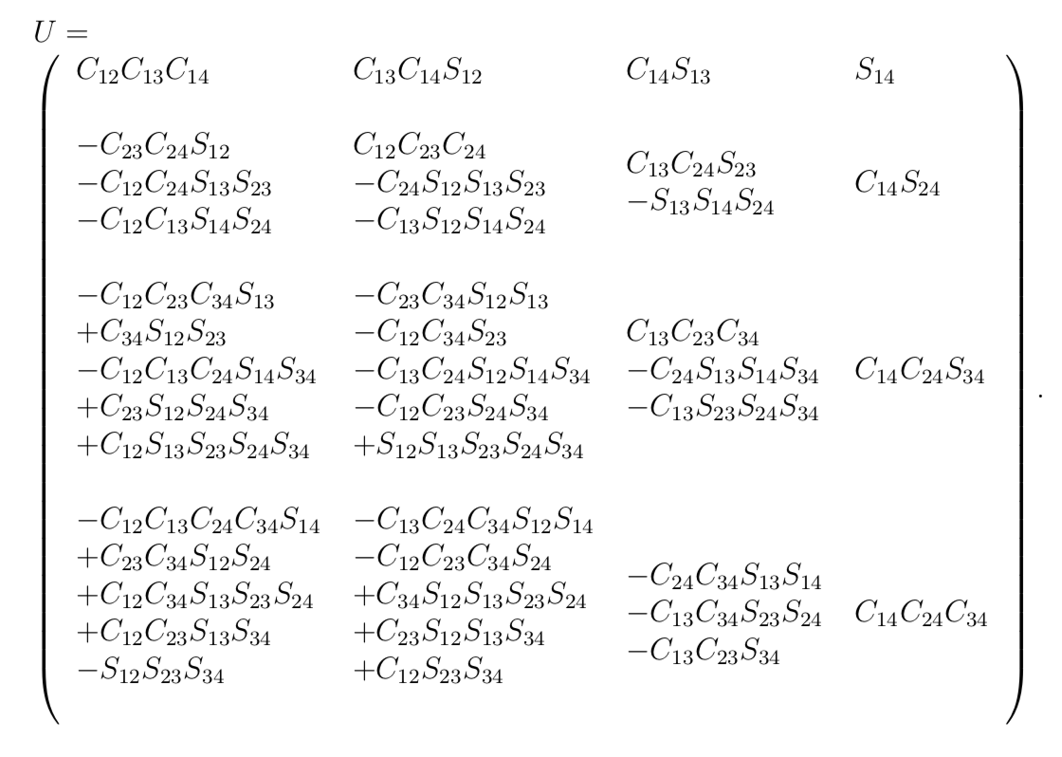
PMNS Matrix: 4x4
$$C_{ij}=cosθ_{ij},S_{ij}=sinθ_{ij}$$

Slide 22
Flavor and Mass Eigenstates
Flavors: Electron, Muon, Tau, Sterile
There are distinct neutrino masses, but they do not correspond uniquely to each of the neutrino flavors.
Neutrino states are not always in pure flavor states, due to quantum superposition we are able to express a neutrino state by
$$ν_{α}=\overset{4}{\underset{i=1}{∑}}U_{αi}ν_{i}$$
$$ν_{i}=\underset{α=e,μ,τ,s}{∑}U_{αi}^{*}ν_{α}$$

Slide 23
Why do physicists care?
63% Dark Matter
10% Neutrinos
15% Photons
12% Atoms

Slide 24
How do we know it exists?
Galaxy rotation curves
Velocity dispersions: statistical dispersion of velocities about the mean velocity of a group of objects
Cosmic microwave background
Redshift space distortions

Slide 25
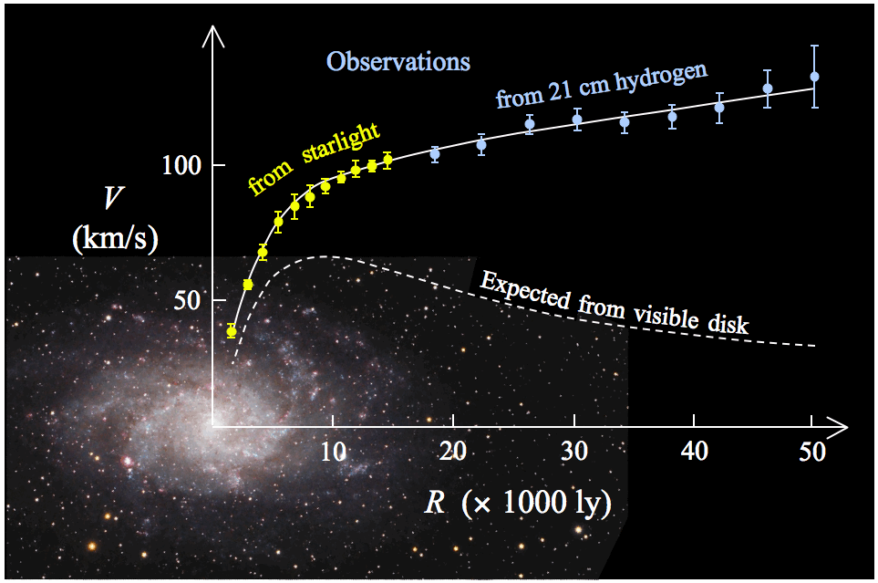
Galaxy rotation curves
The galaxy rotation curve remains flat as distance from the center increases (violation of Kepler’s second law)
Kepler’s second law states a line joining a planet and the sun sweeps out equal areas during equal intervals of time
Type to enter a caption.
Wikipedia contributors. "Galaxy rotation curve." Wikipedia, The Free Encyclopedia. Wikipedia, The Free Encyclopedia, 19 Jul. 2018. Web. 14 Oct. 2018.

Slide 26
What can it be made of?
WIMPs - weakly interacting massive particles (do not interact electromagnetically, that is why they are so hard to detect)
(Remember four forces of nature: Gravity, Electromagnetism, Weak, Strong)

Slide 27
Experiments
MiniBoone experiment at FermiLab (team of scientists including Columbia graduates lead by Georgia Karagiorgi)
GERDA: Germanium Detector Array
LEGEND: Large Enriched Germanium Experiment for Neutrinoless Double Beta Decay
CANDLES: CAlcium fluoride for the study of Neutrinos and Dark matters by Low Energy Spectrometer

